Slide 1
Lidar PointCloud Processing

Slide 2
Lidar PointCloud Processing Pipeline
Lidar PCD
Filtering
Segmentation
Clustering
ObjectList (Class, location, Orientation, velocity)
Fusion
Projection on Camera
Bounding Box

Slide 3
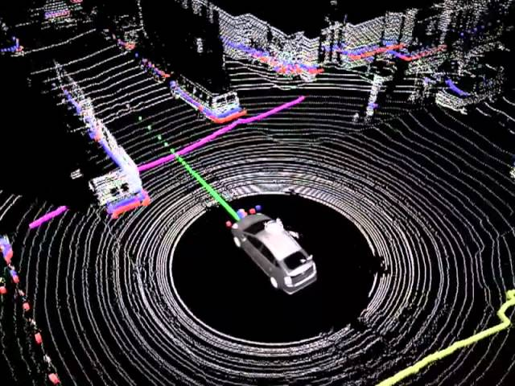
Lidar PointCloud Processing

Slide 4
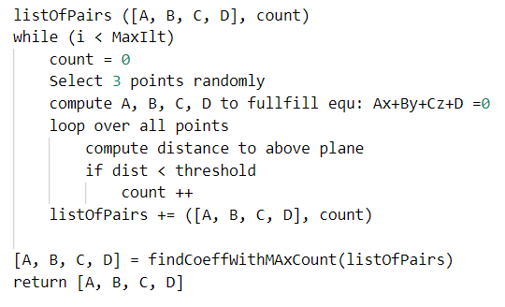
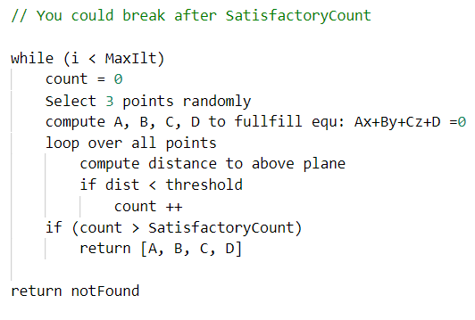
RANSAC Segmentation

Slide 5
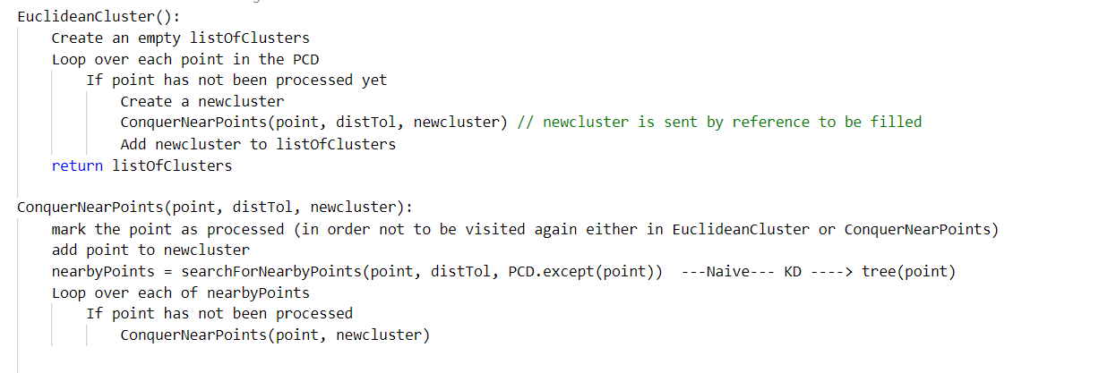
Euclidean Clustering

Slide 6
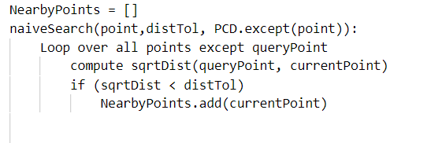
Naïve NearestNeighbour Algorithm

Slide 7
KD Tree Benefits
Group points by how close they are to each other
Avoid calculating distance for possibly many points just because they are not considered in a close enough region
Speeds up closest neighbor search
Example

Slide 8
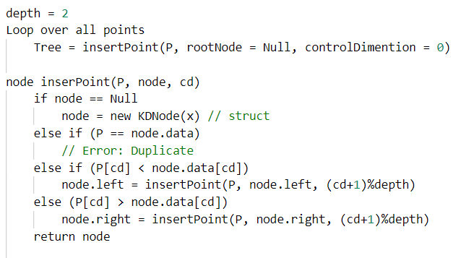
KD Tree Construction
KD Tree Construction

Slide 9
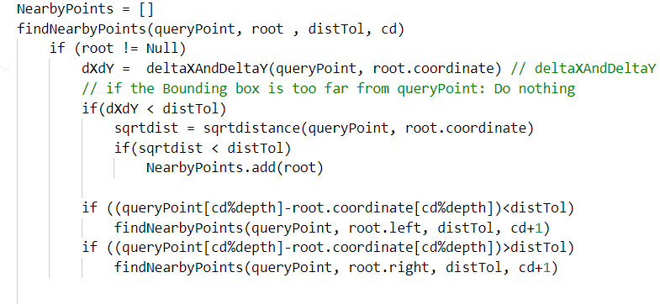
KD Tree search for nearest neighbour
KD Tree Construction

Slide 10
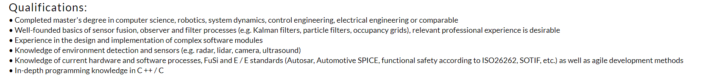
Sensor Fusion Product Owner

